Slide 1

PANIMALAR ENGINEERING COLLEGE AN AUTONOMOUS INSTITUTION DEPARTMENT OF INFORMATION TECHNOLOGY
IT8611 Mini Project Project Review
III year/VI sem
A CUSTOM CHATBOT APPLICATION USING OPENAI
SUNDARAMOORTHY.M
(2020PECIT209)
VISHAL.A
(2020PECIT224)
AKASH.K
(2020PECIT182)

Slide 2
Abstract
Chatbots are software programs that use natural language understanding and processing. This project ‘ A Custom Chatbot Application Using OpenAI’ is typically based on OpenAI's language model technology, which uses advanced artificial intelligence techniques to analyze and generate natural language text. Specifically, it is based on OpenAI's GPT (Generative Pre-trained Transformer) models, which are large neural networks that can generate coherent and contextually relevant responses to user input to create a custom chatbot.The custom chatbot is an an application which can be installed and used in devices unlike web chatbots these chatbots can be customized by changing the layout design,colour,chat icons and the user can change the application according to his business needs and also train the bot to provide response to the user queries.

Slide 3
WHAT IS CHATBOT
CHATBOT IS A COMPUTER PROGRAM THAT USES ARTIFICIAL INTELLIGENCE (AI) AND NATURAL LANGUAGE PROCESSING (NLP) ,AND TO UNDERSTAND CUSTOMER QUESTIONS AND AUTOMATE RESPONSES TO THEM,SIMULATING HUMAN CONVERSATION

Slide 4
TYPES OF CHATBOT
1 Menu/button based chatbot
2 Rule based chatbots
3 keyword recognition based chatbots
4 Machine learning chatbots
5 The hybrid model
6 Voice bots

Slide 5
Existing System
The existing traditional chatbots cant be customized
The existing web chatbots cant be used as an applications and can only be used in web browsers

Slide 6
Requirements of the Project
Hardware Requirement
To run android studios the required hardware specifications are
1.supported cpu models
2nd generation Intel CPU (Sandy Bridge) or newer, AMD CPU with support for a Windows Hypervisor
ARM-based chips, or 2nd generation Intel Core or newer with support for Hypervisor.Framework
Intel Core i5-8400 or better
2.Memory
i) Minimum 8gb RAM is required 16 gb RAM is great to use
ii) Free storage-30 GB (SSD is strongly recommended)
3.Screen Resolution
i) 1920 x 1080

Slide 7
Software Specification
1.supported operating system versions
Windows 8/8.1/10/11 (64-bit)
macOS 10.15 (Catalina)
Any 64-bit Linux distribution that supports Gnome, KDE, or Unity DE
2.Latest version of android studio(flamingo or eel)
3. brainshop AI key

Slide 8
Modules of the Project
INTERFACING
INTERFACING CHATBOT WITH OPENAI KEY
This chatbot provides responses from ai website called brainshop openai ,which is based on generative pretrained model gpt and natural language processing NLP.
Natural language processing (NLP) is the ability of a computer
Program to understand human speech as is spoken also it is a machine learning technology that give computer the ability to interept manipulate and comprehend human language.
Alexa is built based on NLP ,a procedure of converting speech into words,sounds and ideas, and amazon records your words.

Slide 9
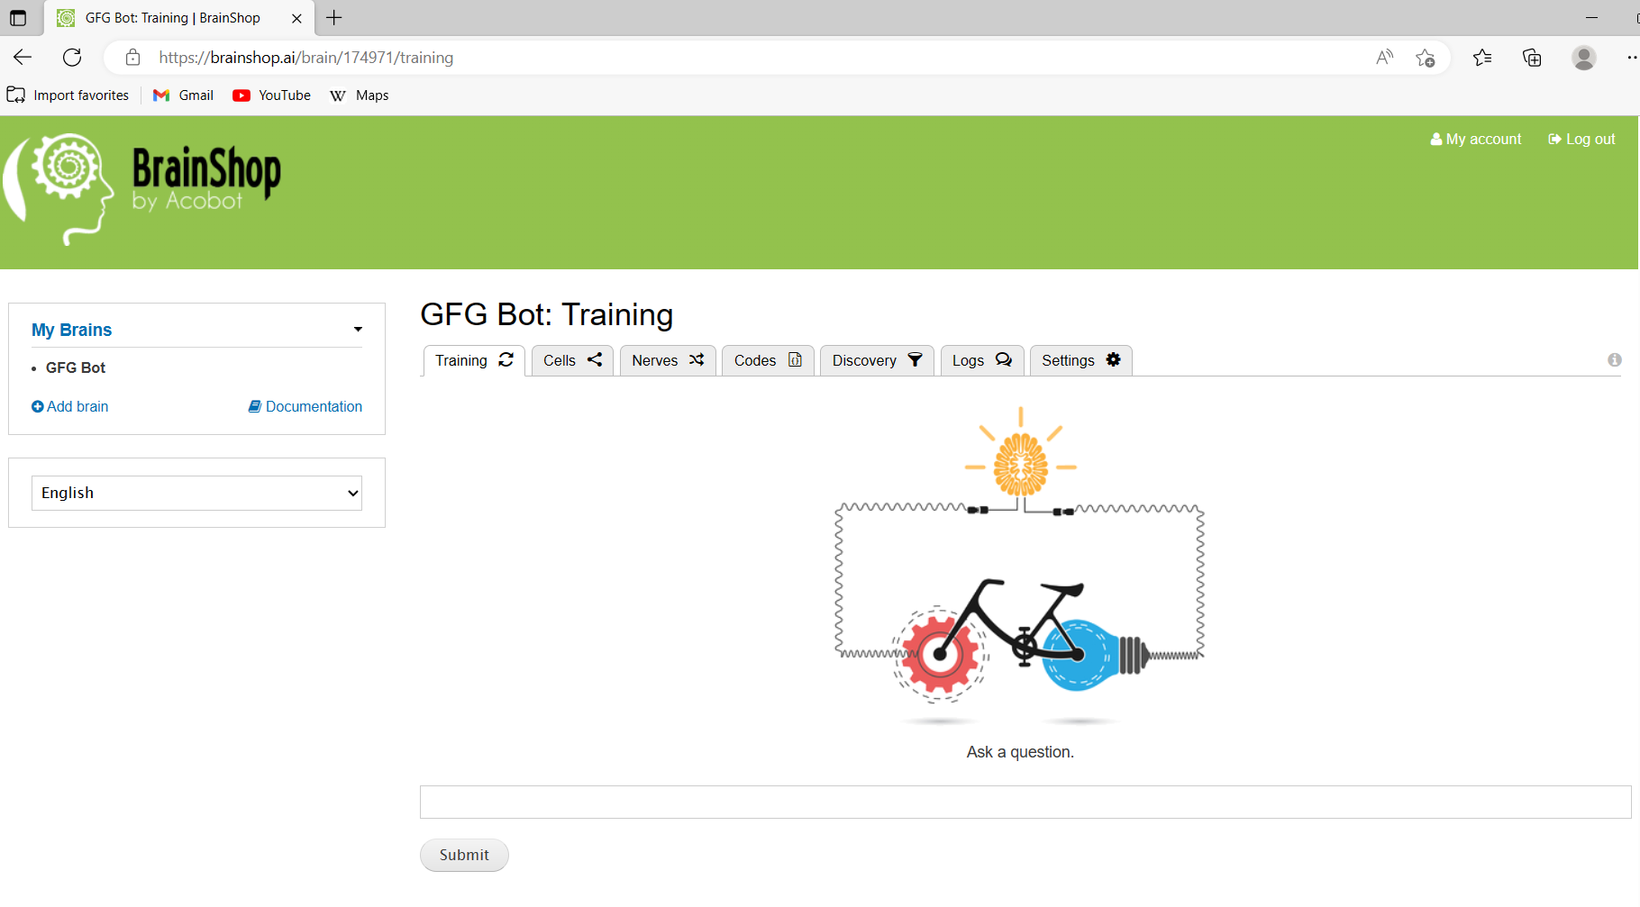
BRAINSHOPAI WEBPAGE

Slide 10
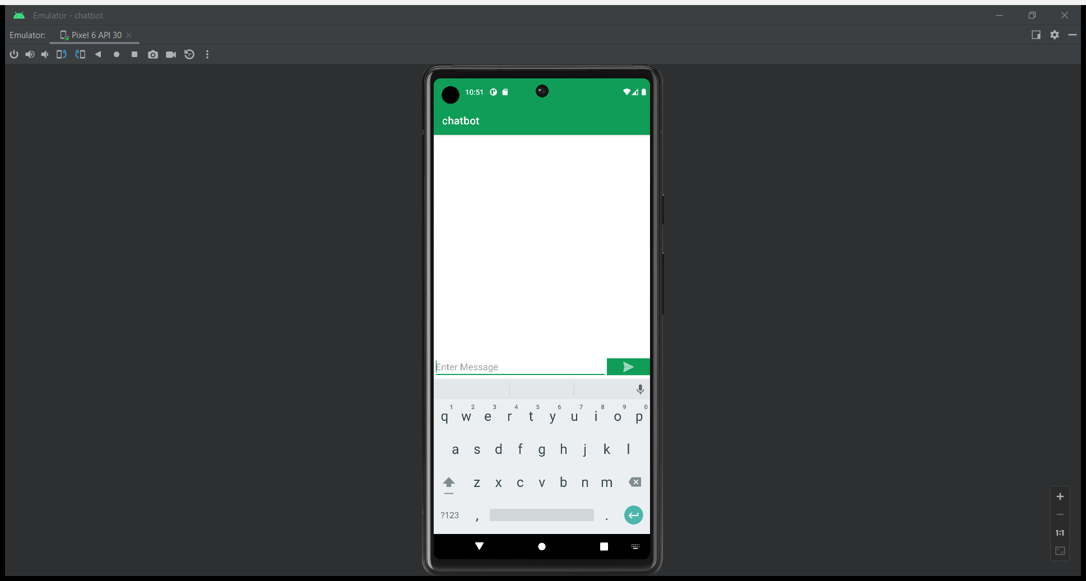
OUTPUT

Slide 11
References
Lo, A., & Ren, Y. (2020). A study of the effectiveness of customized chatbot for e-commerce. Journal of Electronic Commerce Research, 21(3), 267-280.
Li, X., Li, Y., Wang, W., & Li, L. (2020). Development of a customized chatbot for customer service in the retail industry. International Journal of Industrial Ergonomics, 79, 103068.
Radziwon, A., Jabloński, B., & Lupa-Zatwarnicka, K. (2020). Customizing chatbots in the healthcare sector: A review of the literature. Healthcare, 77.
Kesharwani, A., & Mishra, A. (2021). Customized chatbots: An analysis of the key determinants for adoption in e-commerce. Journal of Retailing and Consumer Services, 61, 102556.
Emanuela Haller, Traian Rebedea, “Designing a Chat-bot that Simulates an Historical Figure”, IEEE Conference Publications, July 2013.
Pratik Slave, Vishruta Patil, Vyankatesh Gaikwad, Girish Wadhwa, “College Enquiry Chat Bot”, International Journal on Recent and Innovation Trends in Computing and Communication, Volume 5, Issue 3, March 2015.
“AIML Based Voice Enabled Artificial Intelligent Chatterbot”, International Journal of u- and e- Service, Science and Technology Volume 8 - No. 2, 2015.
Amey Tiwari, Rahul Talekar, Prof. S. M. Patil, “College Information Chatbot System”, International Journal of Engineering Research and General Science, Volume 2, Issue 2, April 2017.
Nimavat, K., Champaneria, T.: Chatbots: an overview types, architecture, tools and future possibilities. Int. J. Sci. Res. Dev. 5, 1019–1024 (2017) 35.
Kucherbaev, P., Bozzon, A., Houben, G.-J.: Human-aided bots. IEEE Internet Comput. 22, 36–43 (2018). https://doi.org/10.1109/MIC.2018.25209534

